Slide 1
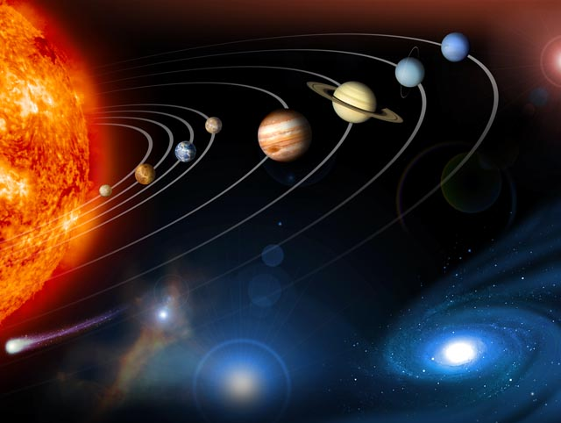
The Planets
Science 10
Astronomy

Slide 2
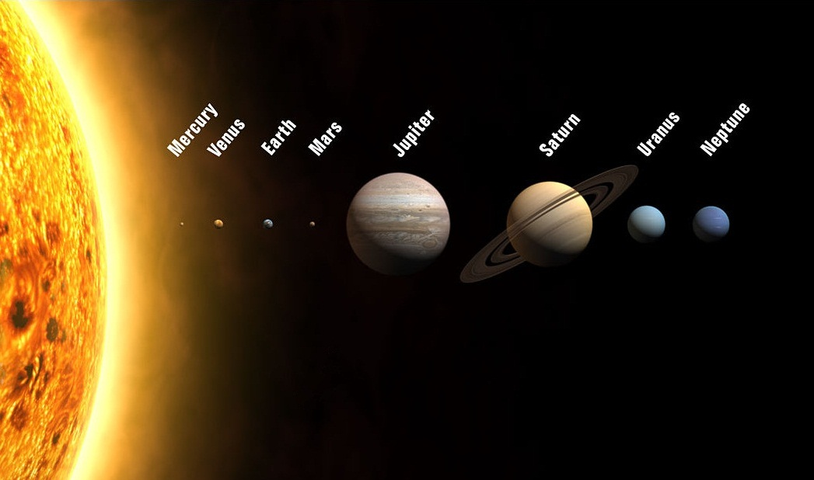
The Solar System
When a star forms from a nebula, gravity pulls most of the material into the new star.
However some may also clump together to form large objects called planets

Slide 3
What is a planet?
In our solar system, there are 8 planets
According to the International Astronomical Union (IAU), the definition of a planet is now officially known as a celestial body that:
1. is in orbit around a star
2. has sufficient mass for its self-gravity to overcome rigid body forces so that it assumes a hydrostatic equilibrium (nearly round) shape
3. has cleared the neighbourhood around its orbit

Slide 4
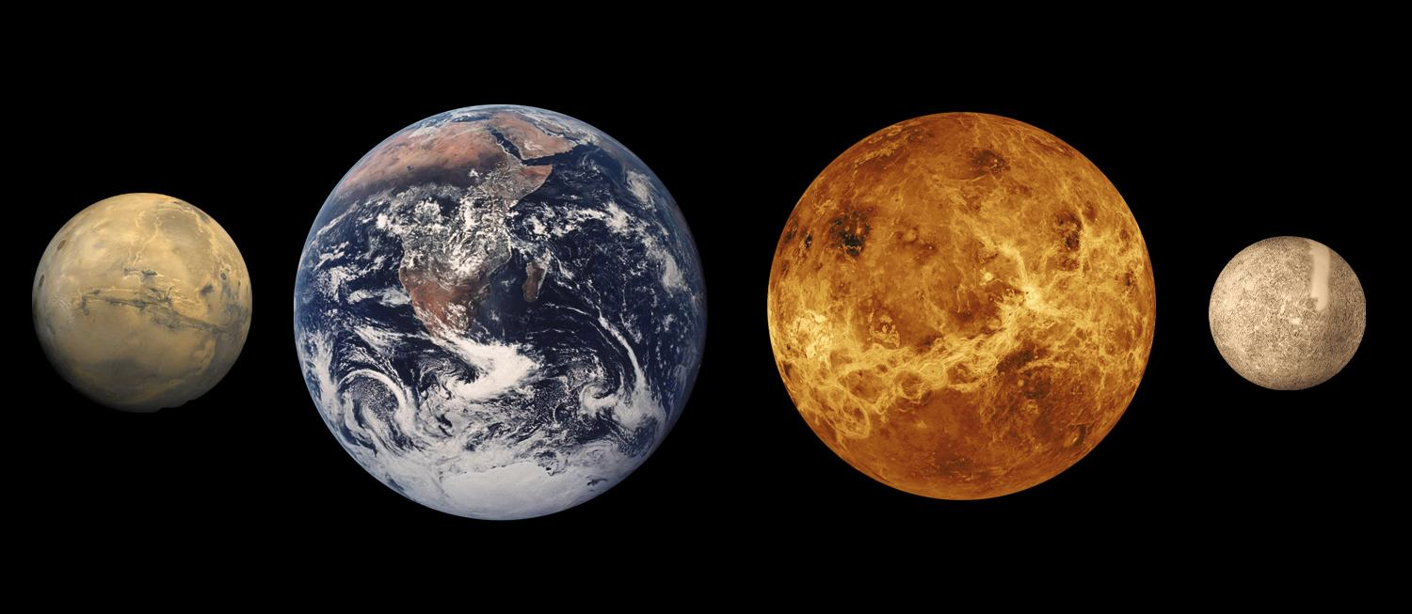
Inner Planets
rocky planets closest to the sun (terrestrial planets)
all have/had a rocky crust, dense mantle layer and a very dense core.
all contain metals
Mercury, Venus, Earth, Mars

Slide 5
Inner Planets

Slide 6
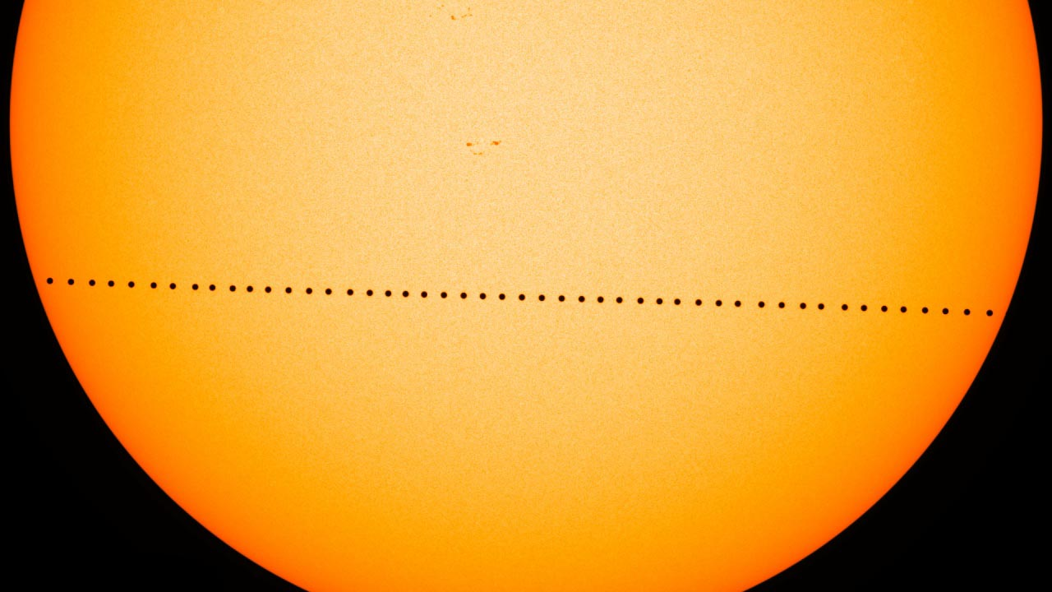
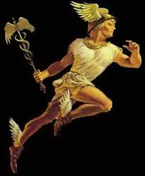
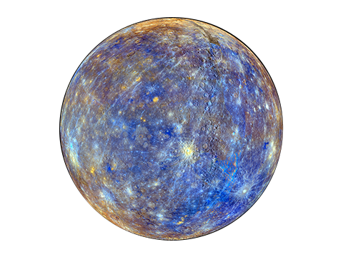
Mercury
Mercury Transit - Nov 2019
orbits the sun every 88 earth days, rotates every 176 earth days
this means a year is shorter than a day on Mercury
smallest and innermost of the terrestrial planets
was investigated by Mariner 10 in 1974/75
it has no real atmosphere nor any moons
weak gravity
has large iron core and magnetic field
Temperature ranges from -180°C to 400°C
pockmarked with numerous impact craters

Slide 7
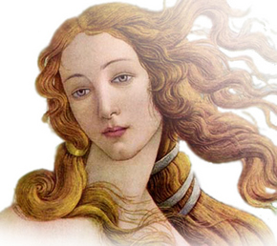
Venus
Orbits the sun every 225 earth days but it rotates (clockwise) every 243 earth days
this means a Venusian year is shorter than a Venusian day
known as Earth’s twin (similar diameter, mass, gravity)
weak magnetic field
Often referred to as the evening star
impossible to see the surface from earth due to a thick pale yellow clouds of sulphuric acid
Hottest planet in the solar system due to greenhouse effect the average temperature 465℃

Slide 8
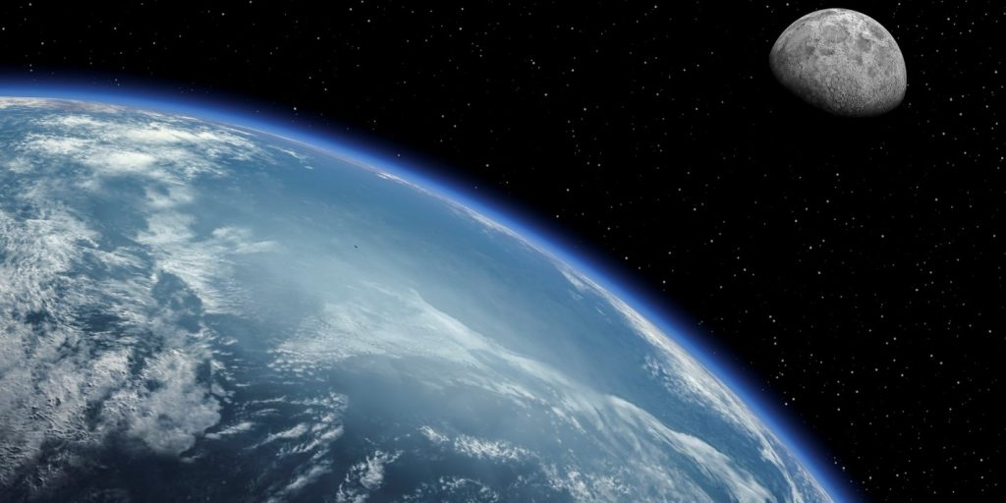
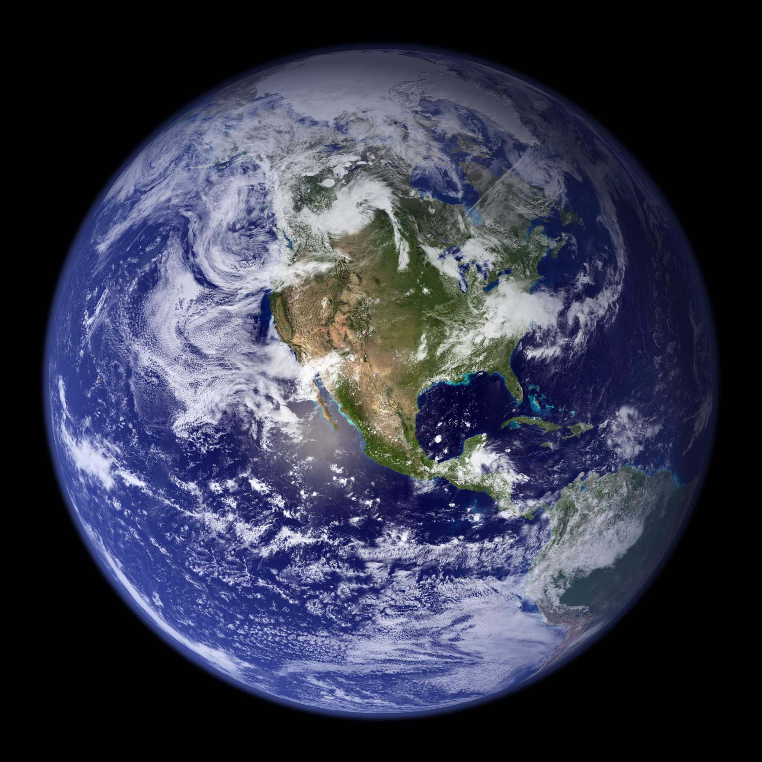
Earth
Orbits the Sun every 365.25 days
Name come from German “Die Erde” meaning “the ground”
Largest of the inner terrestrial planets
Only planet known to support life
Has one natural satellite… the moon
Atmosphere made of 78% Nitrogen, 21% Oxygen
Temperature range -88℃ to 58℃
Rotation 24 hrs at 467 m/s; Revolution 365.25 days at 29 km/s
Axis tilt 23.5°

Slide 9
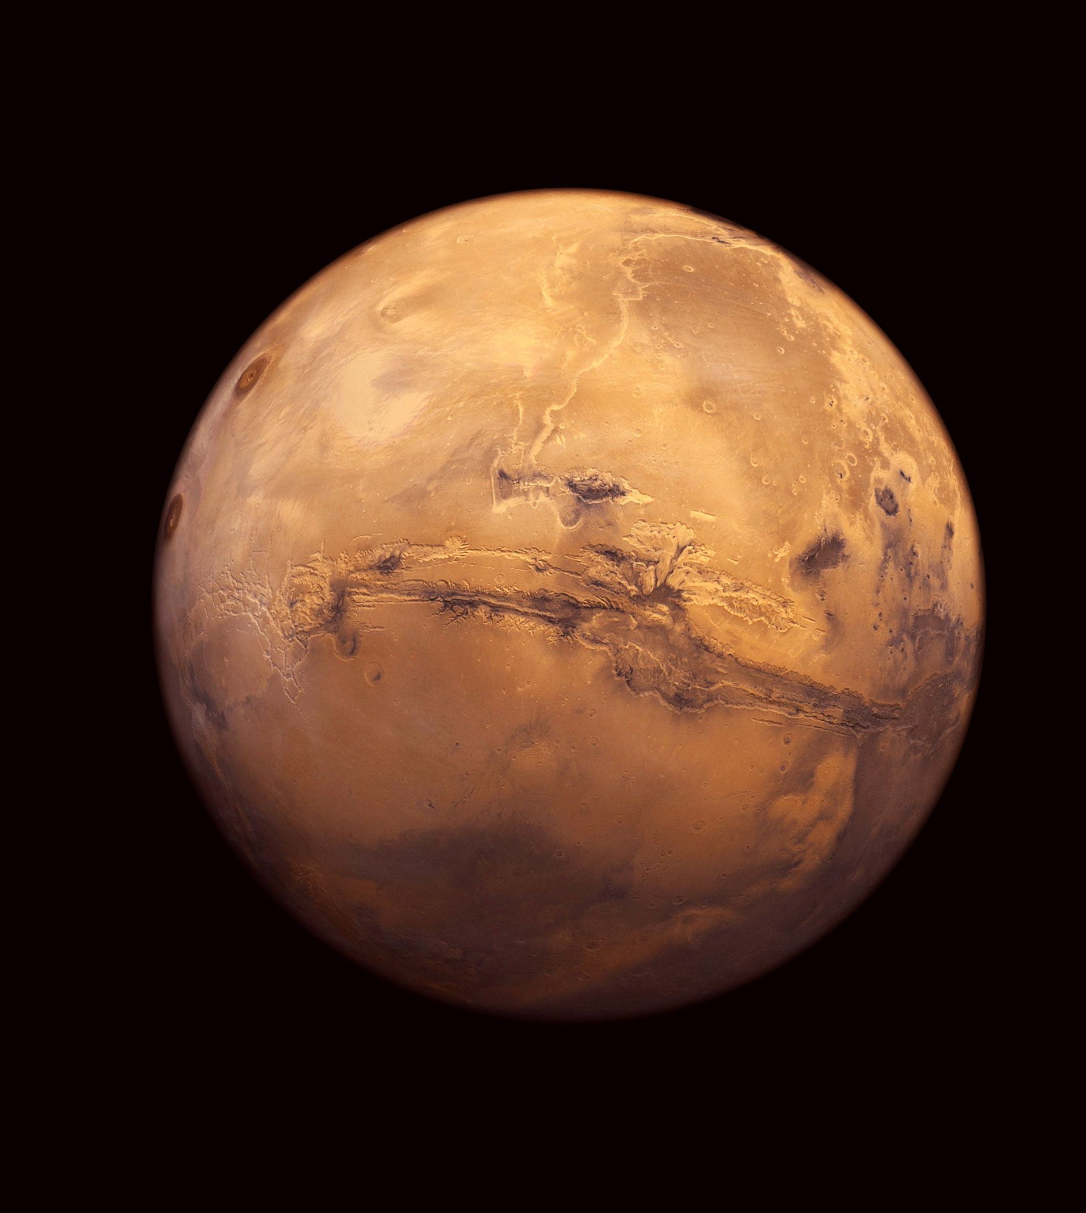
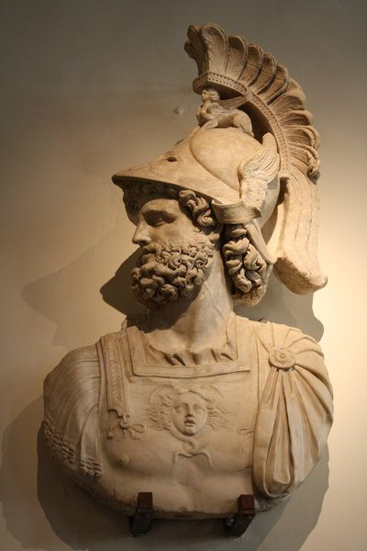
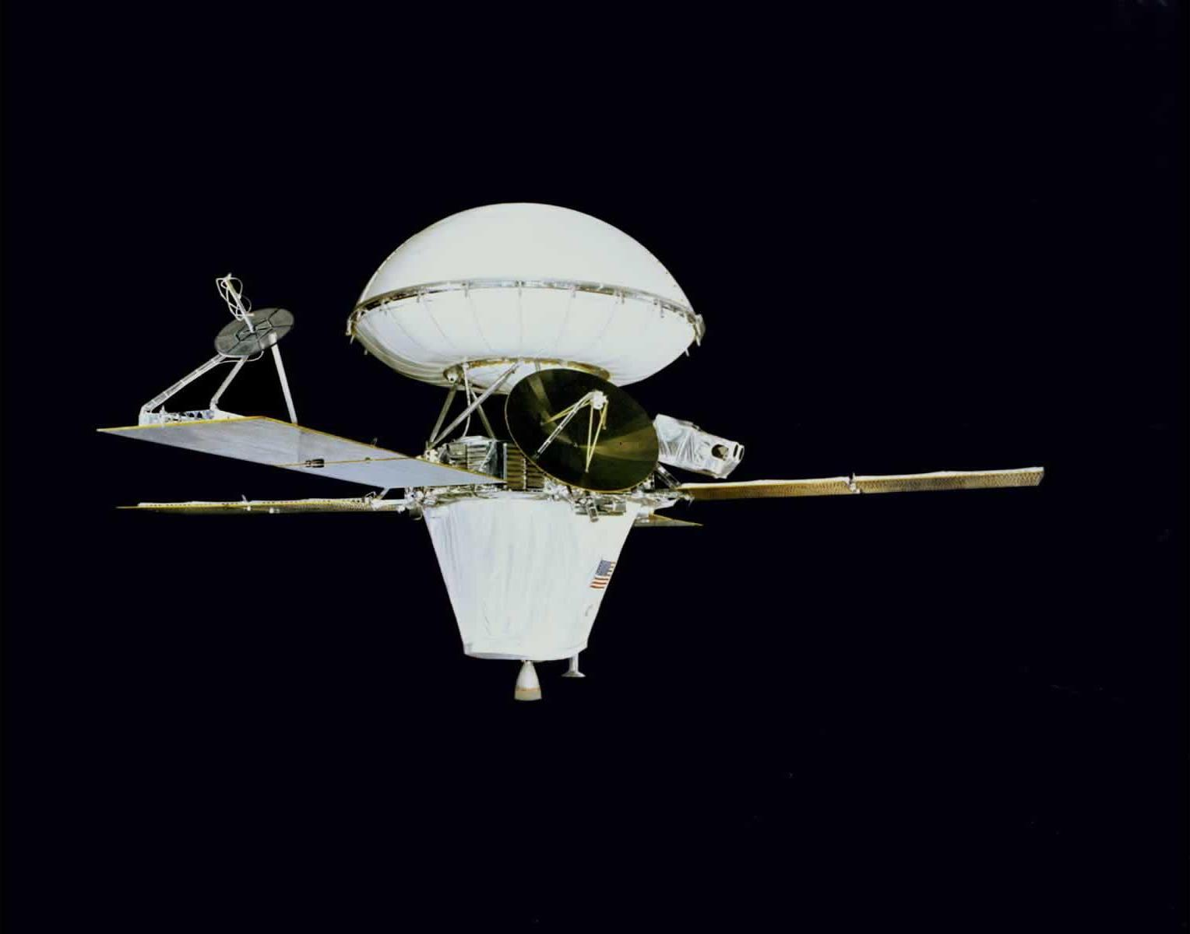
Mars
Has 2 moons - Phobos & Demos
Was first visited by Vikings 1 & II
May be the only other planet able to harbour water and life (has polar ice caps)
Has the largest mountain - Olympus Mons
Has the largest valley - Valles Marineris
The surface is made mostly of Fe2O3
Temperature ranges -140℃ to 20℃
Orbit 687 Earth days
Rotation: just more than one Earth day (24 hrs 37 min)

Slide 10
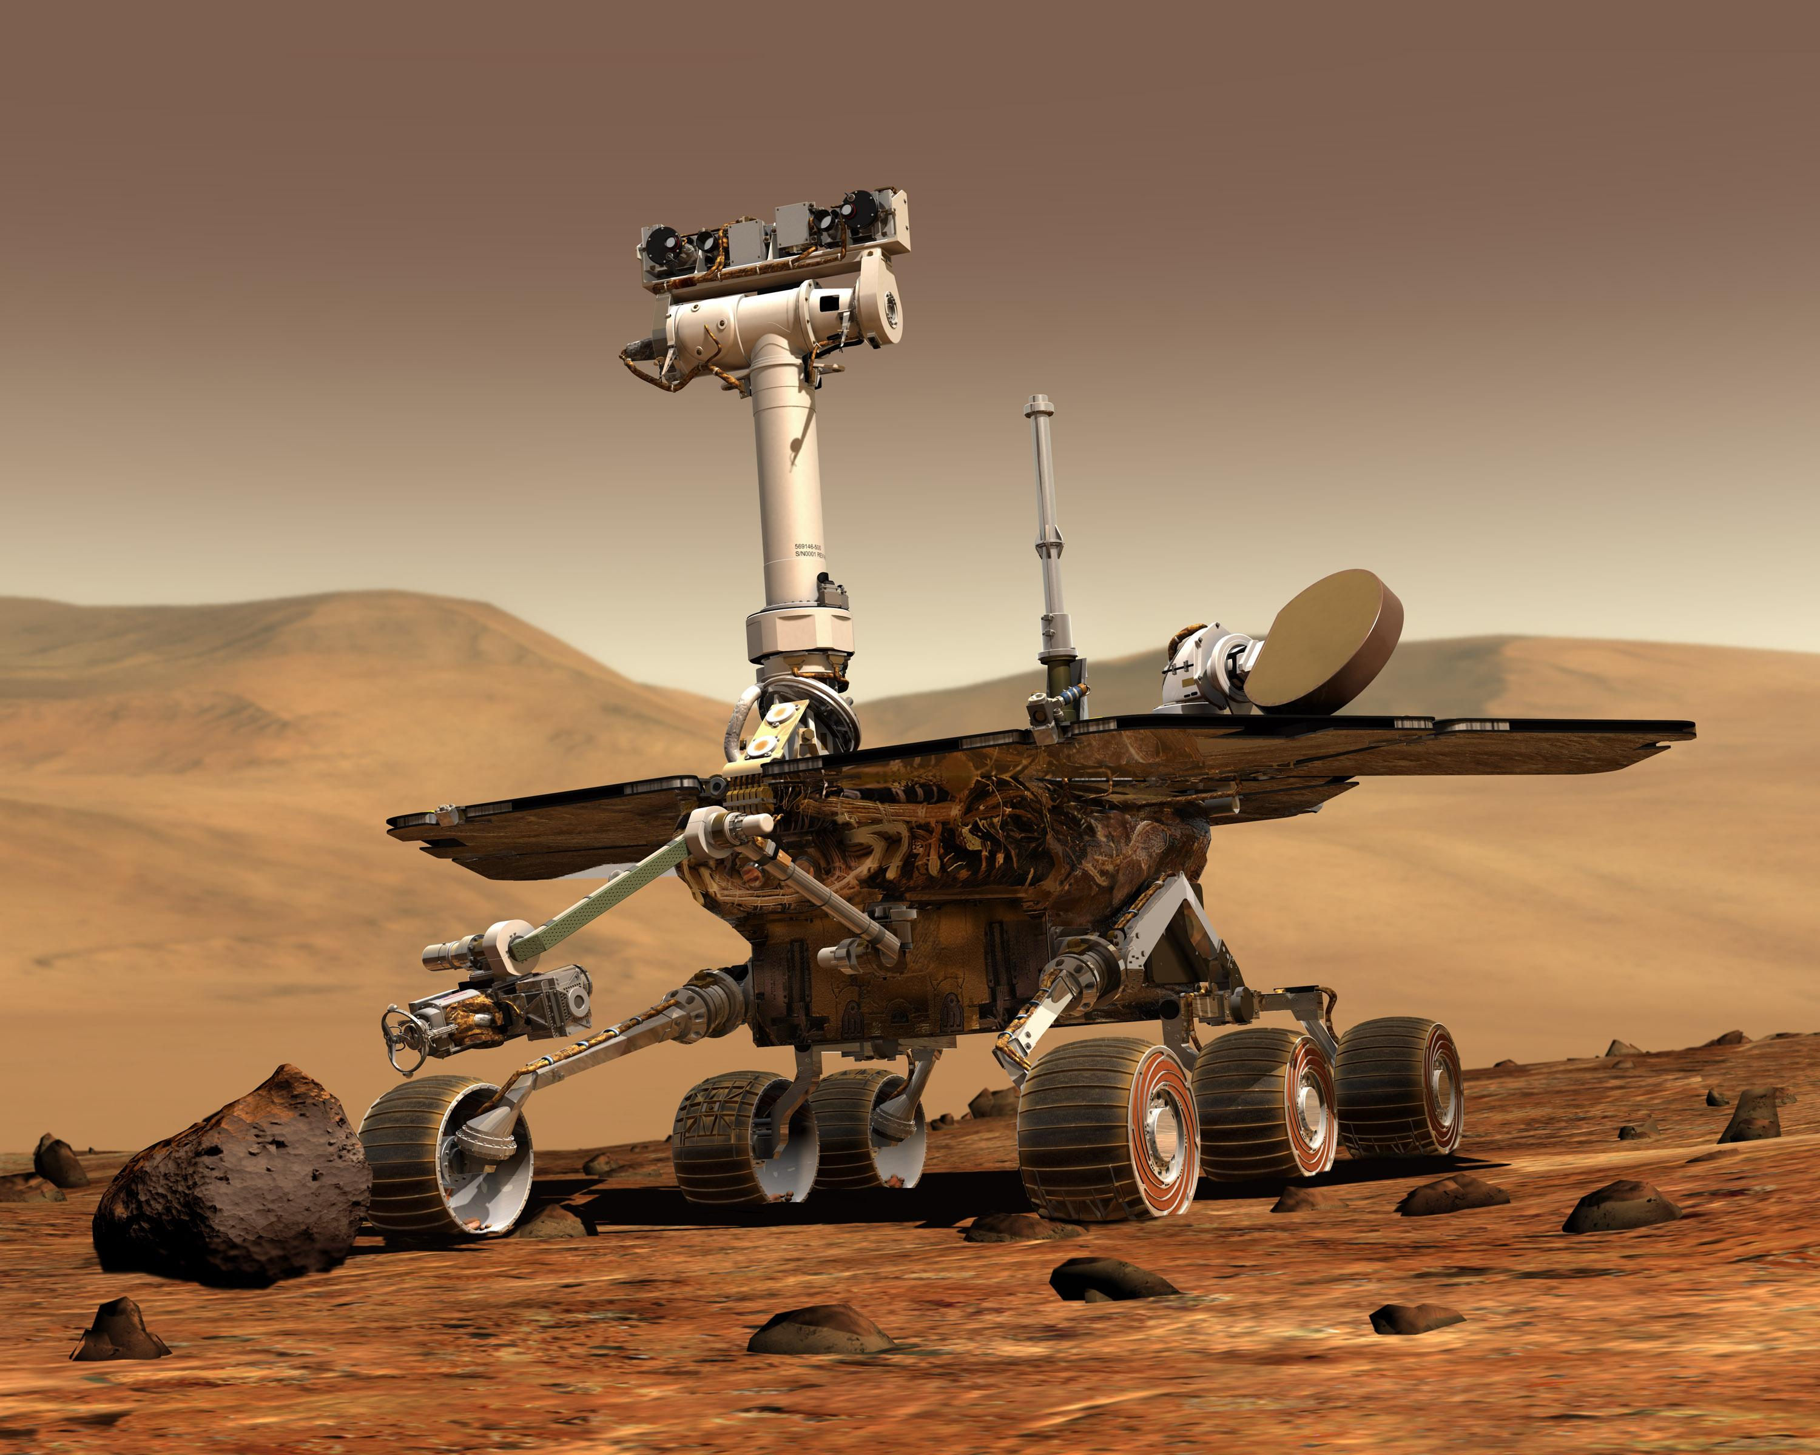
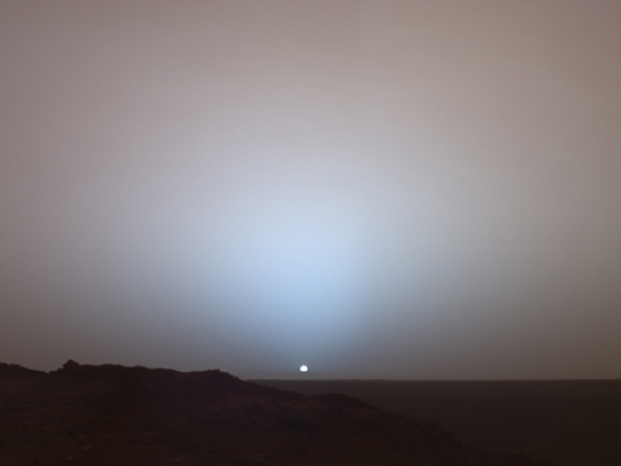
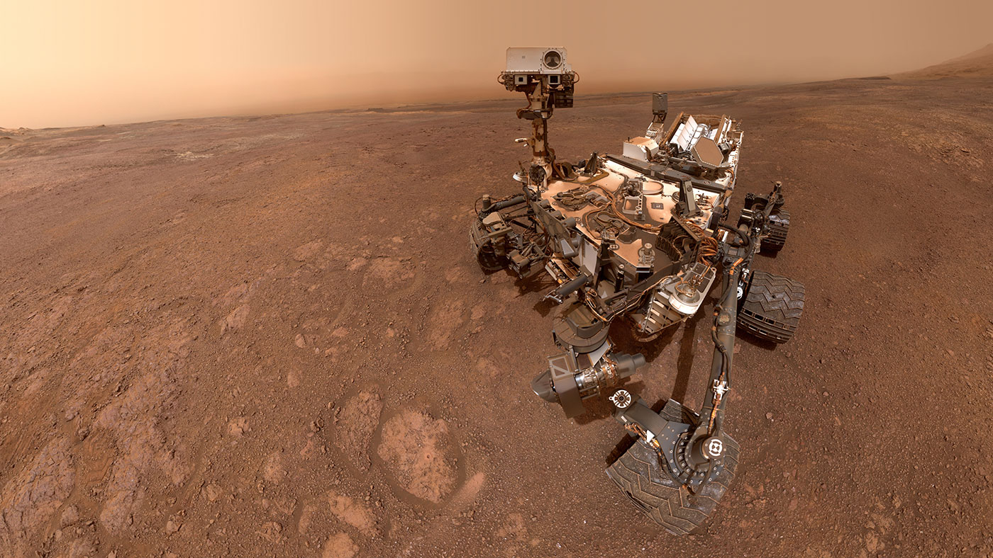
Martian sunset take by
Spirit rover, may 2005
Mars rover Curiosity selfie,
May 29, 2019
Notes:
Spirit stopped communicating with Earth on March 22, 2010, after it got stuck in a sand trap

Slide 11
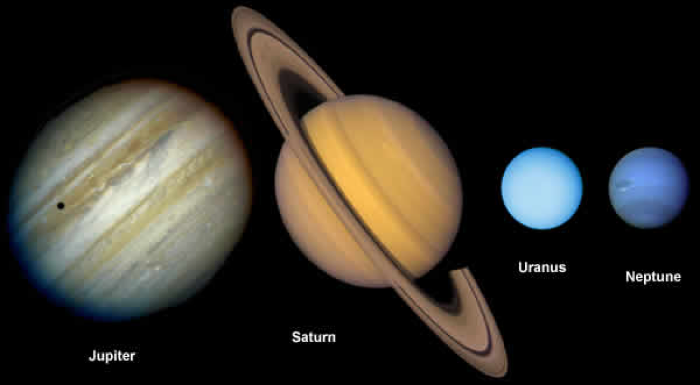
The Outer Planets
AKA the Gas Giants
Farther away, large , gaseous, windy & violent

Slide 12
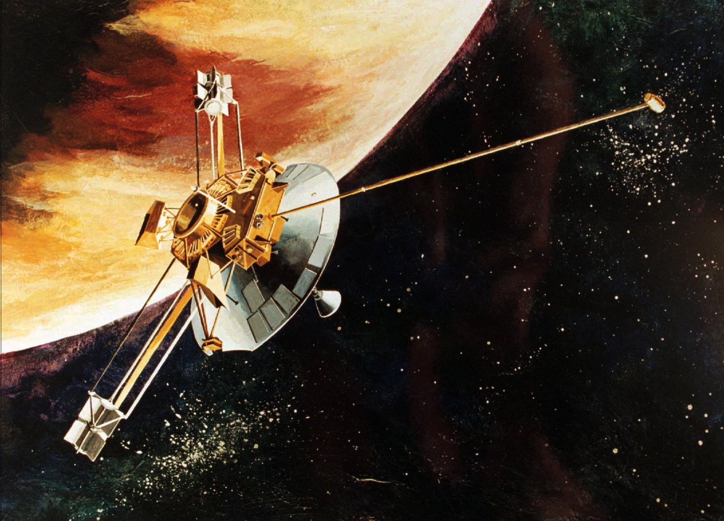
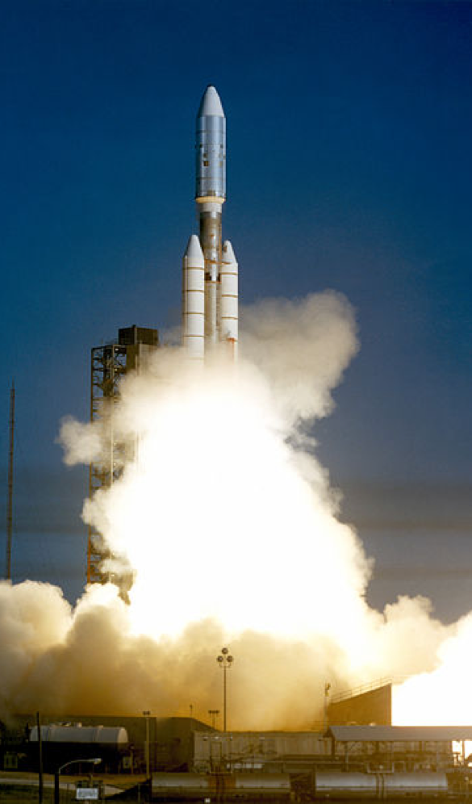
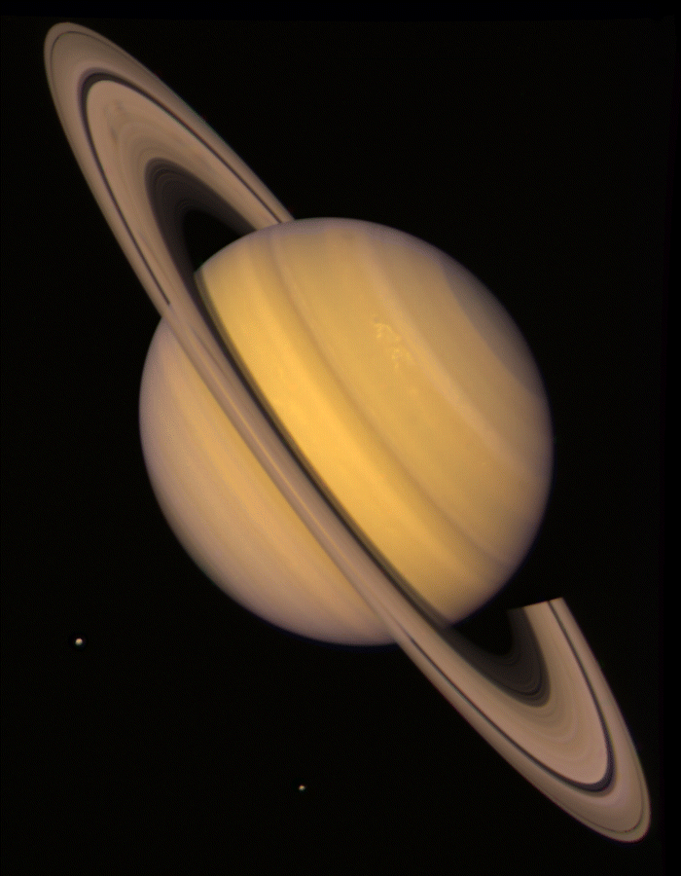
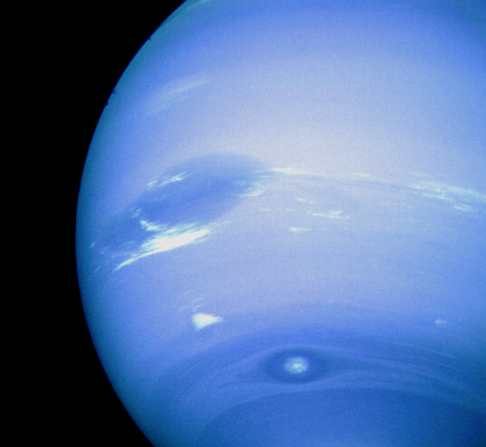
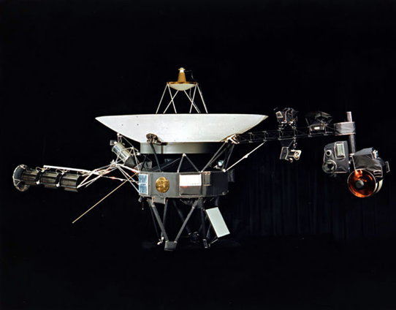
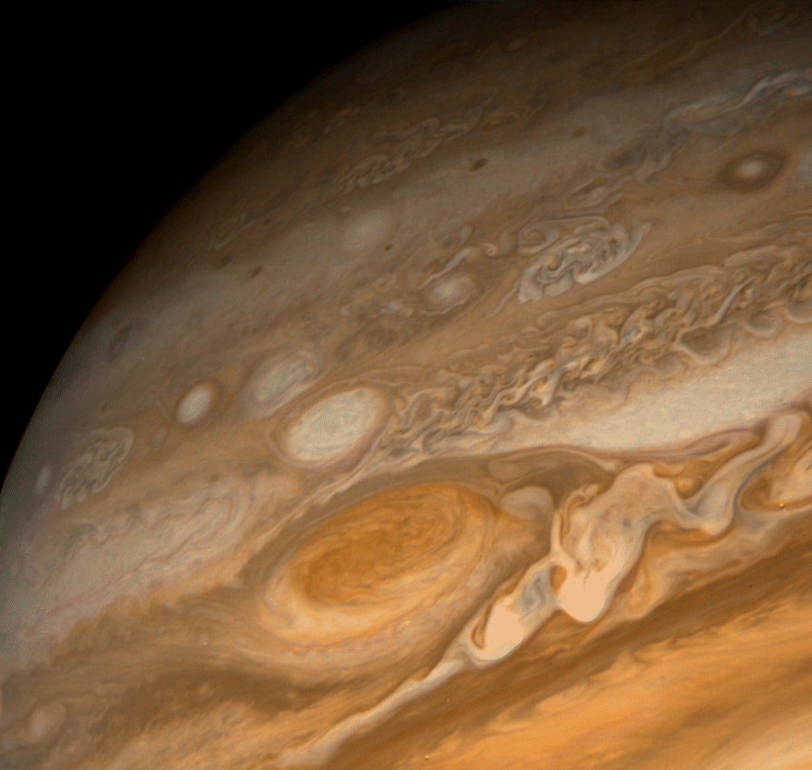
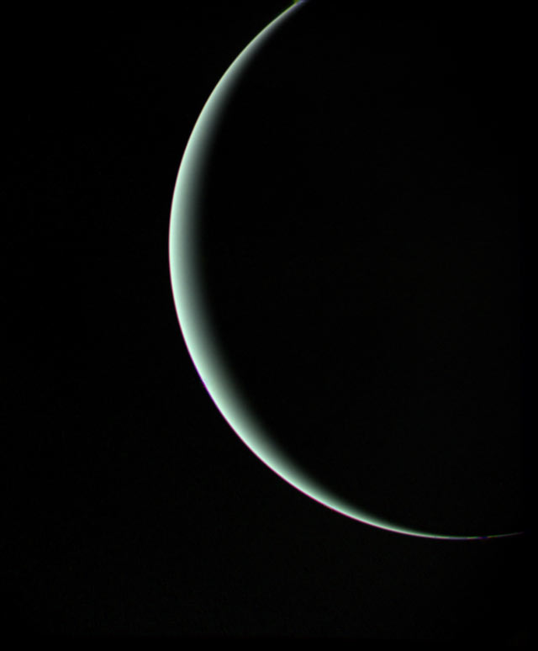
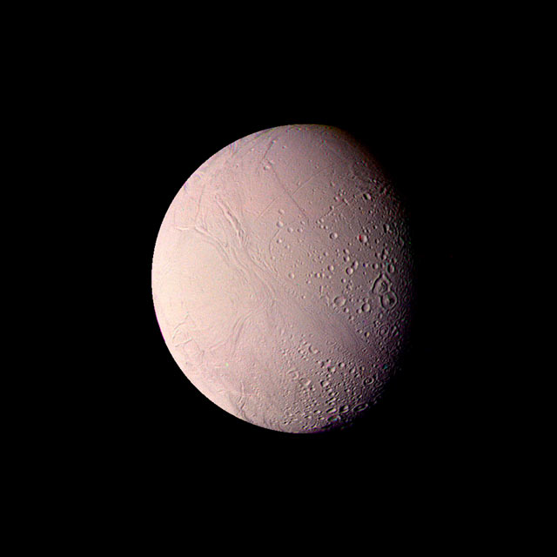
Visiting the Gas Giants
9 spacecraft have be sent to explore the outer planets
Starting with Pioneer 10 in 1973 to Jupiter
NASA sent out 2 space craft, voyager 1 & 2 in 1977
Voyager 1 entered interstellar space in 2012 and Voyager 2 in 2018
Pioneer 10
Voyager 1
Jupiter
Neptune
Saturn
Uranus
Enceladus
Notes:
Pioneer 10 1973 flyby Jupiter & moons
Pioneer 11 1974 flyby Jupiter & Saturn
Voyager 1 & 2

Slide 13
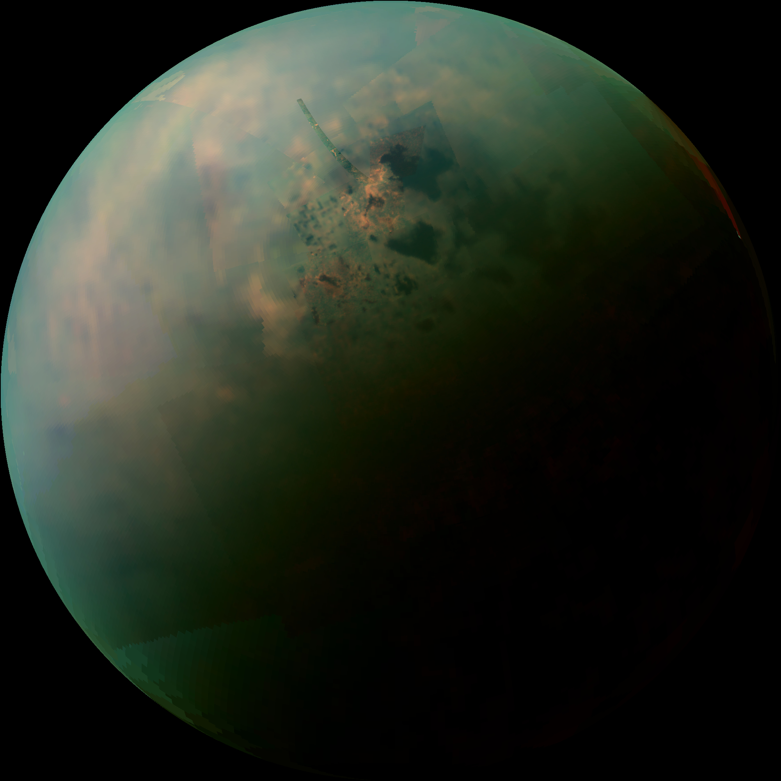
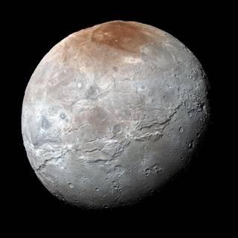
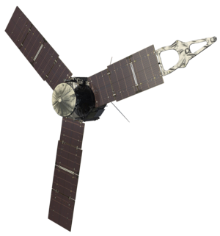
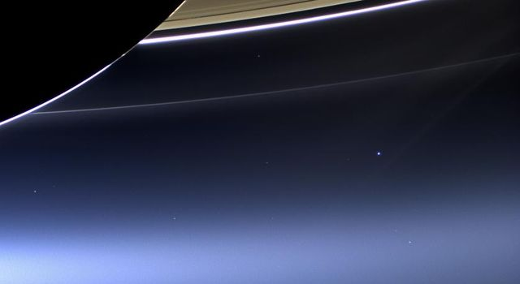
Visiting the Gas Giants
Titan
Galileo 1995-2003 orbit Jupiter & moons
Cassini-Huygens launched in 1997. Mission to explore Saturn, its rings and moons, with a focus on Titan
New Horizons sent to study Pluto & its moon
Juno mission to Jupiter 2016-2021
Pluto’s moon Charon
Juno

Slide 14
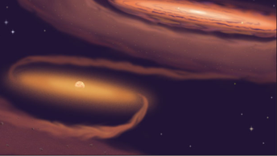
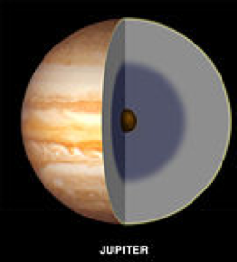
3 Questions to Discuss
1. Why are gas giants always far away from the star they orbit?
2. Can you fly through Jupiter? Why or why not?
3. Why is Jupiter critical to life on Earth?

Slide 15
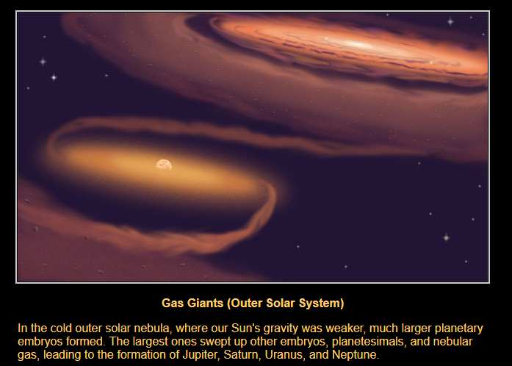
TPS 1: Gas Giant Formation
Why are gas giants always far away from the star of the system?

Slide 16
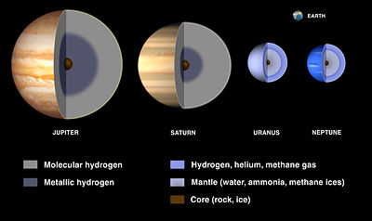
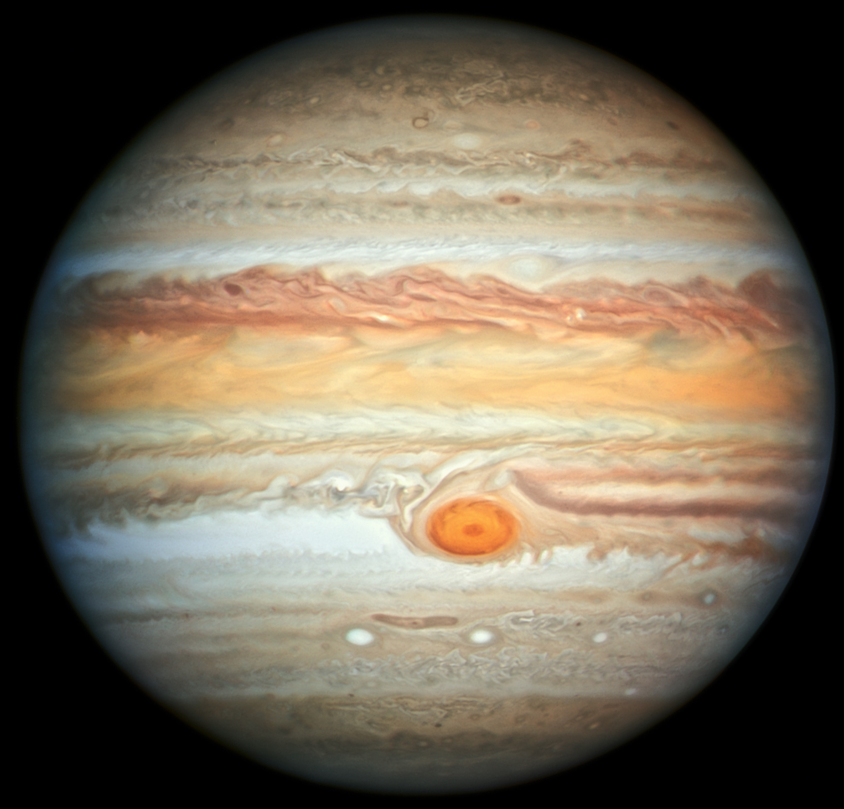
TPS 2: Can you fly through Jupiter? Why or why not?
It is a common misconception that the entire gas giant is made of gas. In reality, gas giants look more like this.
EVEN if you could get close to the core,
1 - The winds on Jupiter are 370 km/h.
2 - The temperature closer to the core is 20,000º C due to high pressure and gravity

Slide 17
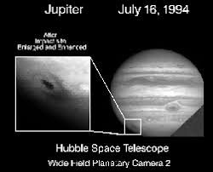
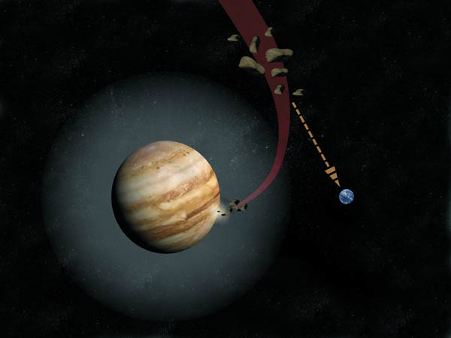
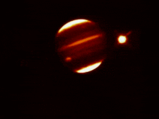
TPS 3: Why is Jupiter critical to life on Earth?
Jupiter is constantly saving our planet from utter destruction.
Due to its incredibly large mass and strong gravitational pull, Jupiter absorbs rogue asteroids on a regular basis.

Slide 18
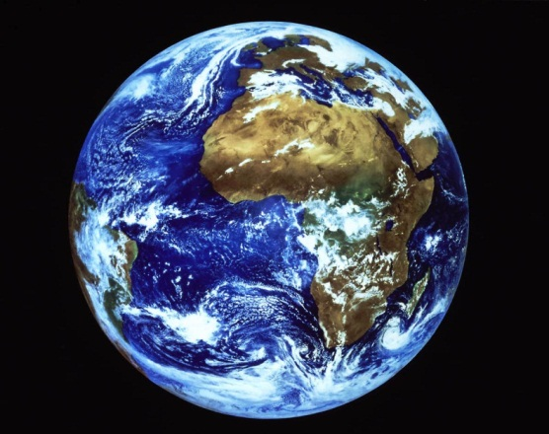
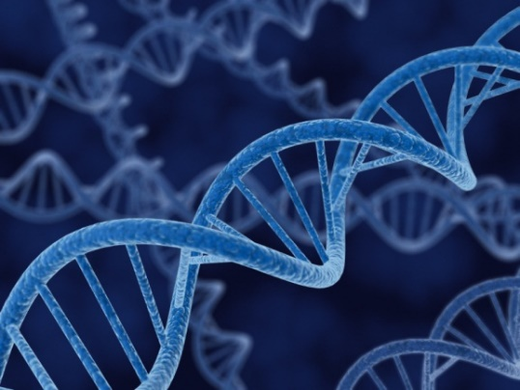
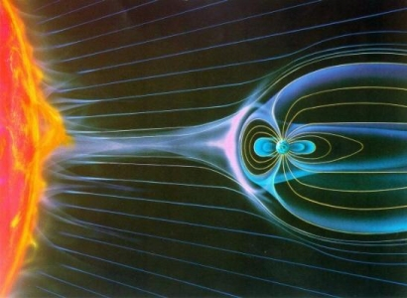
Requirements for Life
Life on Earth is unique to our solar system. And this requires certain things:
1. Life is requires 26 chemical elements.
95% of life is built on CHNOPS.
These 6 elements are the building blocks of all life on Earth through DNA.
2. The planet must be terrestrial, with a solid magnetic core and atmosphere.
The magnetic core deflects radiation from the sun.
The atmosphere controls the temperature.

Slide 19
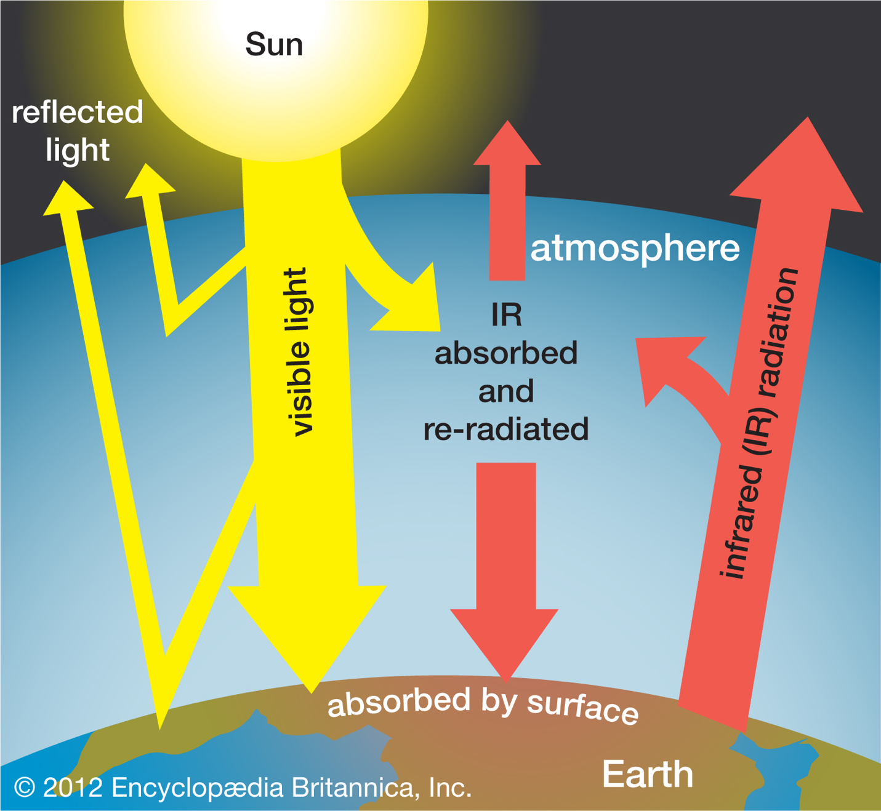
Atmosphere & Temperature

Slide 20
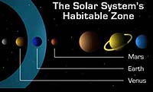
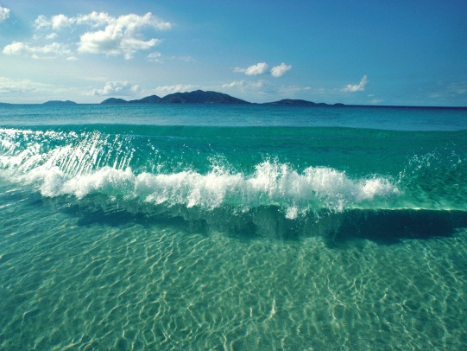
Requirements (Cont.)
3. The planet must be in the “Goldilocks zone” … Not too hot, not too cold.
Life requires liquid water.
It acts as a solvent in biochemical reactions.
IF the planet is too close, the water boils.
IF the planet is too far, the water freezes.

Slide 21
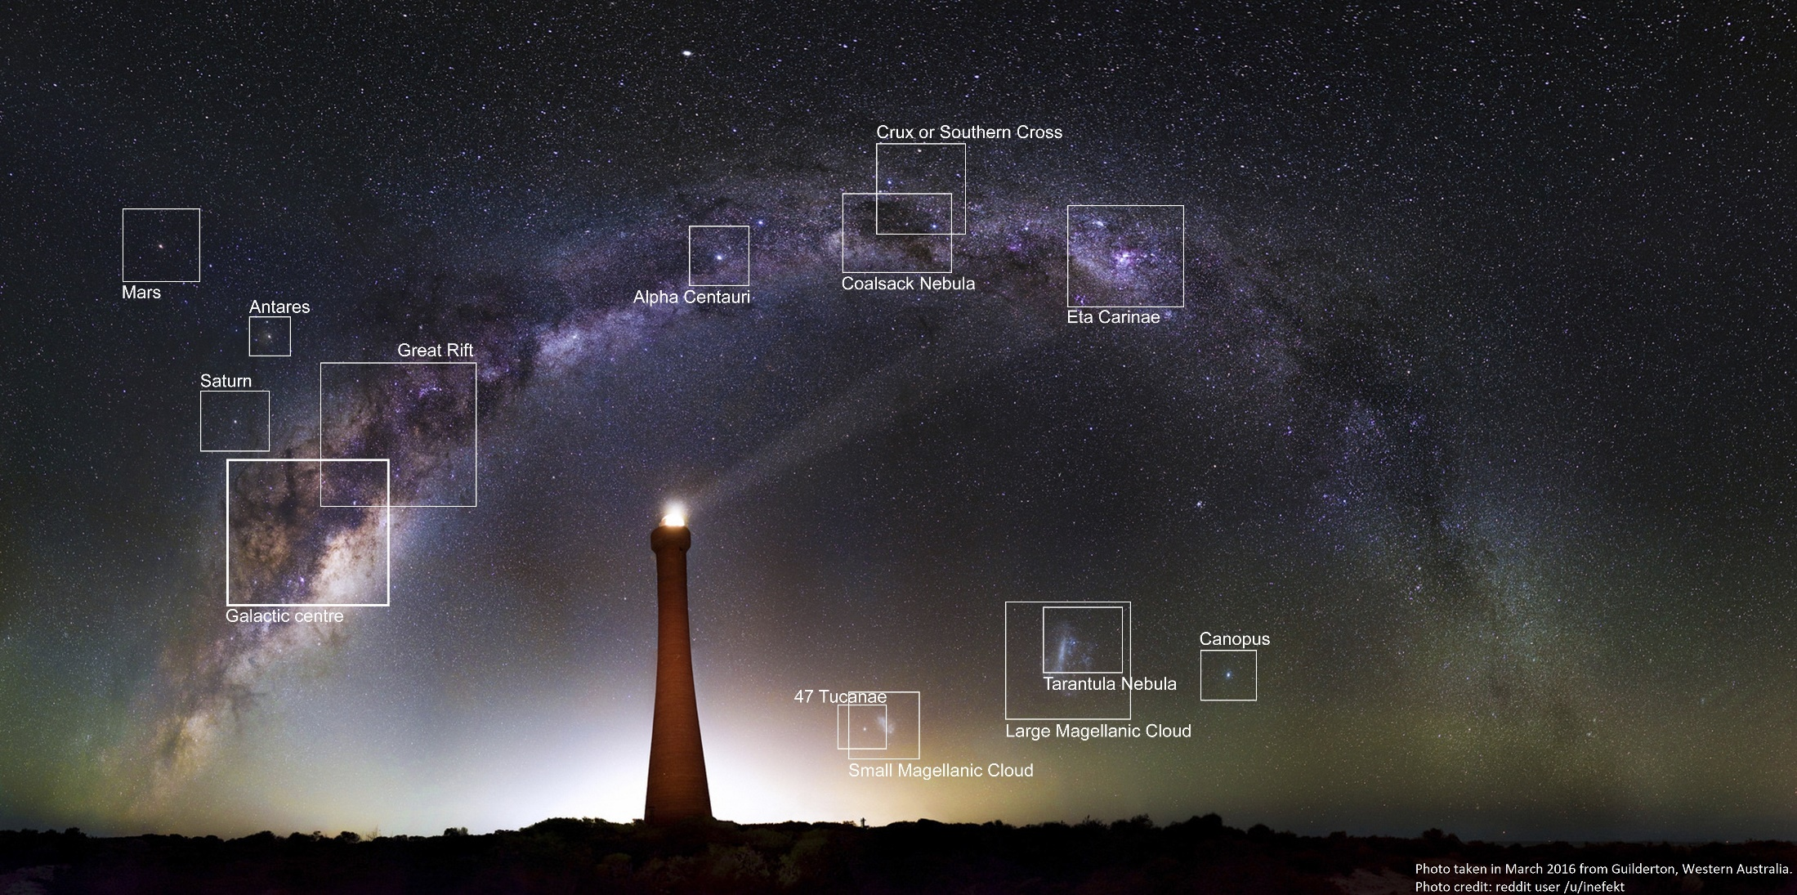
Is there life out there?
There are approximately 250,000,000,000 stars in our galaxy alone, EACH with their own planets!!

Slide 22
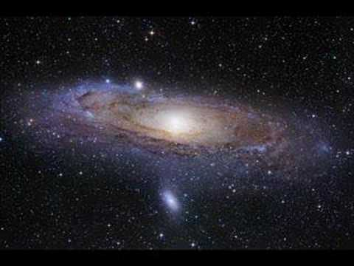
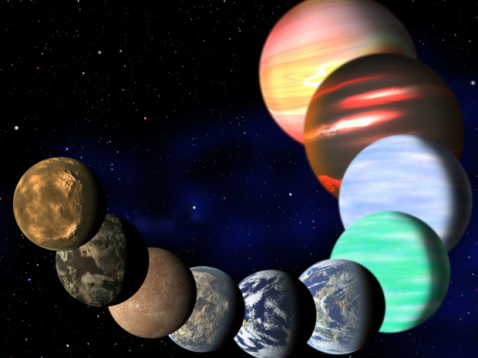
At least 17 billion Earth-like planets across the Milky Way
A new estimate suggests that there is AT LEAST 17 billion planets similar in size to our planet in OUR GALAXY
It doesn’t mean all are habitable, but the sheer number of Earth-size planets is a good starting point in the search for worlds like our own.

Slide 23
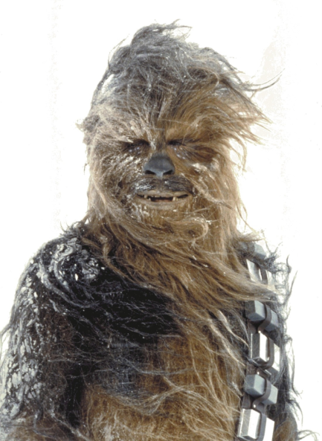
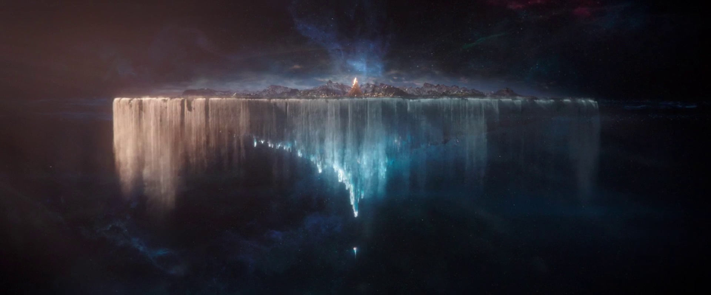


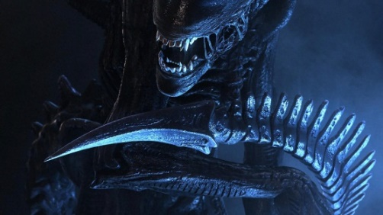
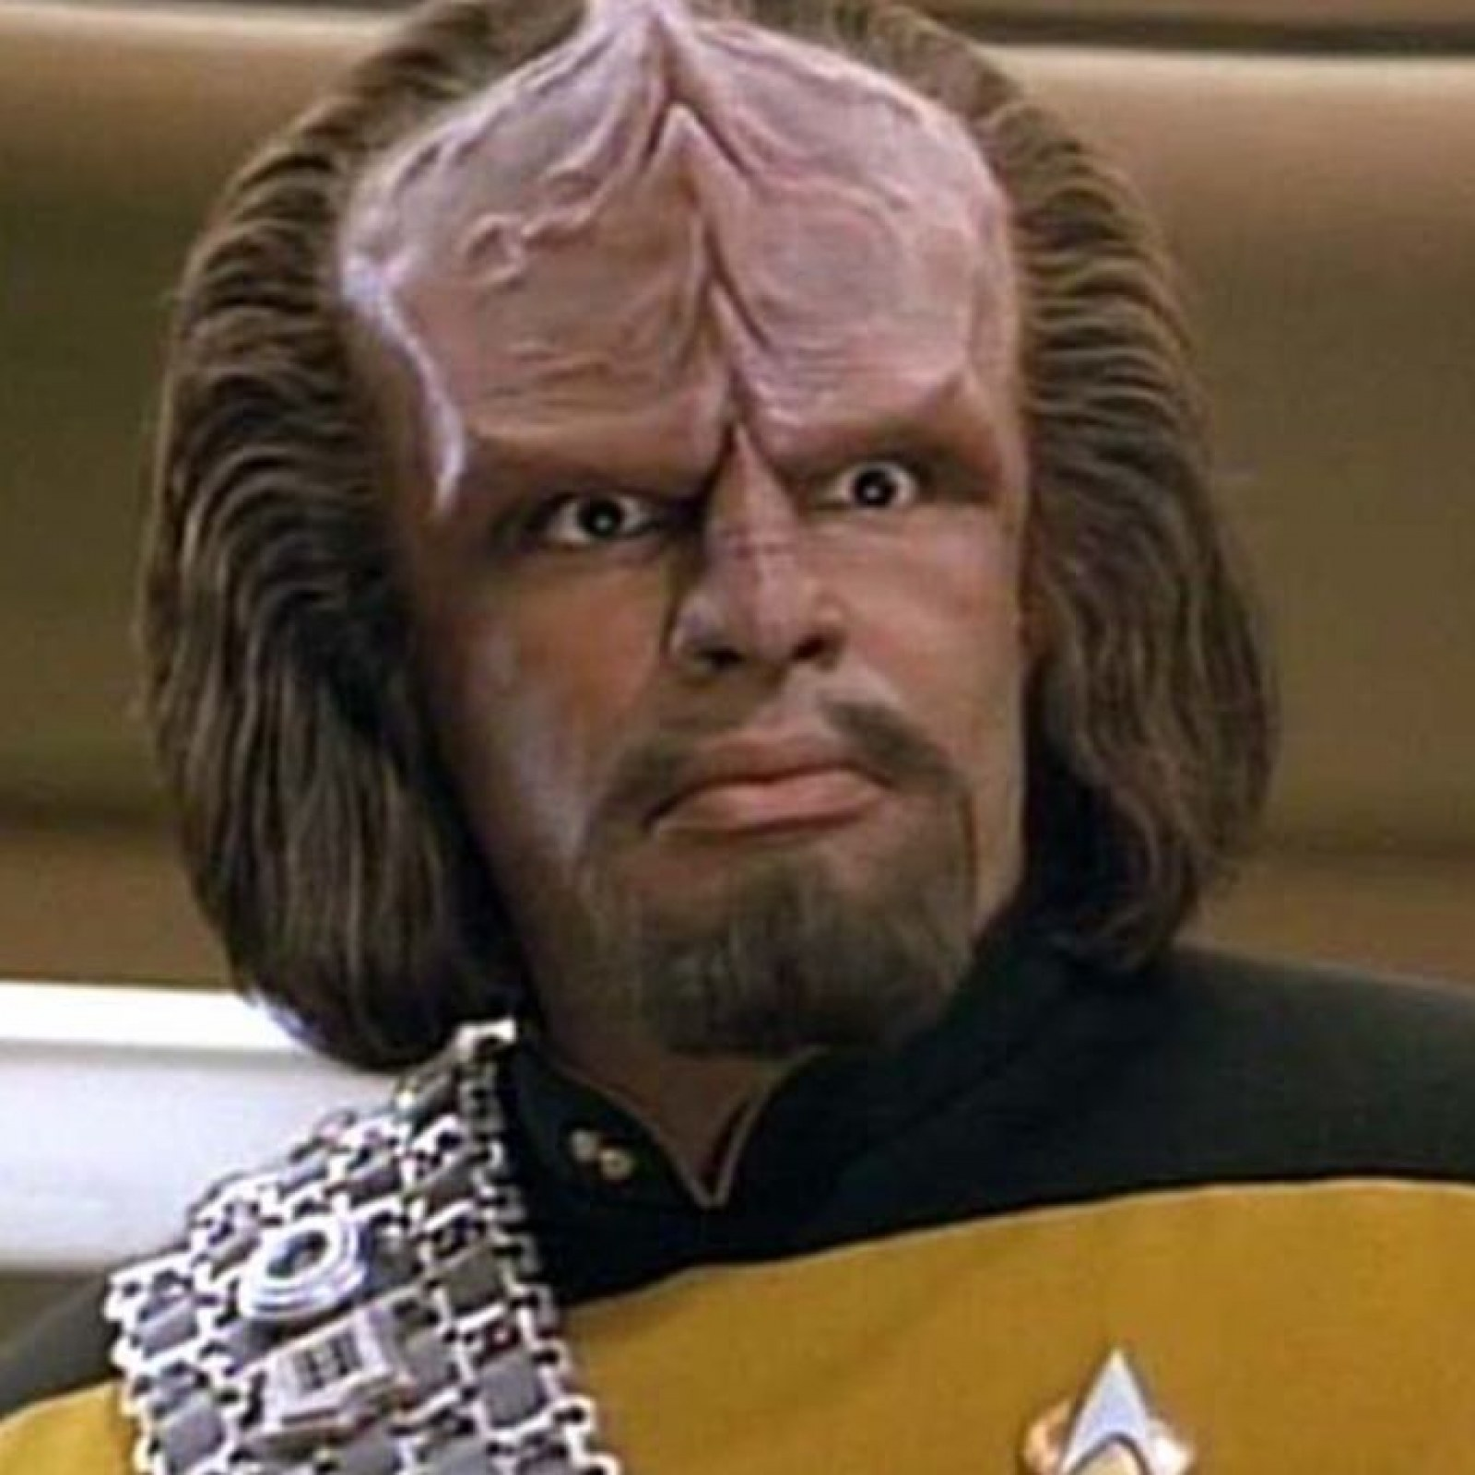
Alien Life
The chances of extraterrestrial life are quite large.
If there is AT LEAST one out of 17 billion planets is in the "Goldilocks Zone”, then these could be our galactic neighbours… Proxima Centauri b

Slide 24
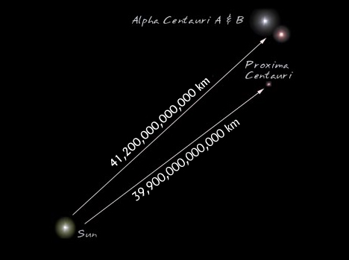

We will never see them….
The closest star is Proxima Centauri.
39 trillion km away.
This takes light 4.22 years to travel.
Using current technology it would take 6,300 years to reach
However, we may be able to send messages to our neighbours… Just with a time delay of 4 years 80 days

Slide 25
Assignment
Planet CUT-OUT Activity
&
12.4 CYU Q #2-8, 16-19

